Slide 1
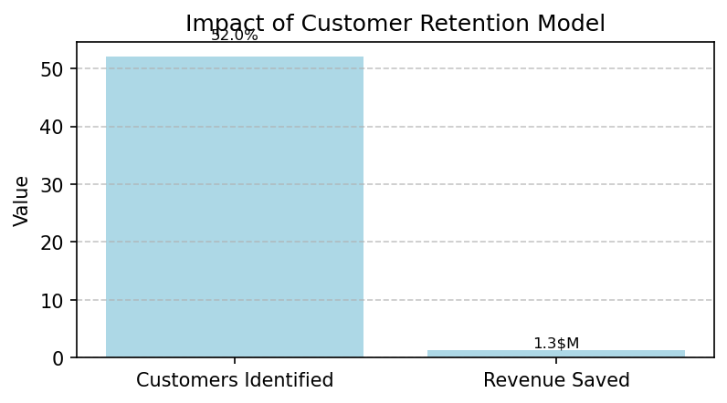
Executive Summary: Keeping SME Customers
Situation
Our SME division is losing customers, which hurts revenue and growth.
Complication
About 10% of customers leave each year, costing millions. Current efforts to keep them are not targeted effectively.
Question
Can we identify customers likely to leave and keep them with better strategies?
Answer
Our solution identifies over half of at-risk customers, potentially saving $1.3M yearly by keeping 260 customers through targeted offers like discounts. Key factors: contract length, energy usage. Next Steps: Launch retention campaigns with these insights.

